Slide 1
Dr. Serap Ulusam Seçkiner
Spring 2014

Slide 9
“IE228_SubeX_GrupX_ReportZ”

Slide 10
Dormitory design
Cafe service design
Carpet factory design
Facility design
Service management design
…

Slide 13
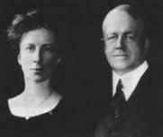

Slide 14
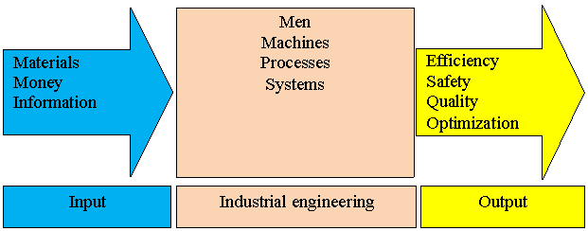

Slide 42
